Slide 1
Android & iOS SIP application
-By Mayank

Slide 2
Table of Contents
Purpose and problem
Solution
Methodology
Result
Challenges
Key Learnings
References

Slide 3
Purpose and Problem:
In mobile operating systems like iOS and Android, background app activity is restricted to conserve battery life. This can prevent VoIP applications from directly receiving incoming calls when the app is not actively running in the foreground (screen off state).
This limitation affects many third-party SIP clients, including Zoiper and Linphone, as they cannot reliably notify users of incoming calls while in the background.

Slide 4
Solution
Push Notifications:
Integrate a push notification service like Firebase Cloud Messaging (FCM) in the Linphone source code.
This allows the server to send a notification to the user's device even when the app is in the background.
Tapping the notification can bring the app to the foreground, allowing the user to answer the call.

Slide 5
Solution
What Is FCM?
Firebase Cloud Messaging, or FCM for short, is a cloud-based messaging service that provides the following capabilities:
Reliably send messages to mobile or web applications, referred here forth as “clients”.
Send messages to all or specific clients using topic or subscription-based addressing.
Receive messages from clients in a server application.

Slide 6
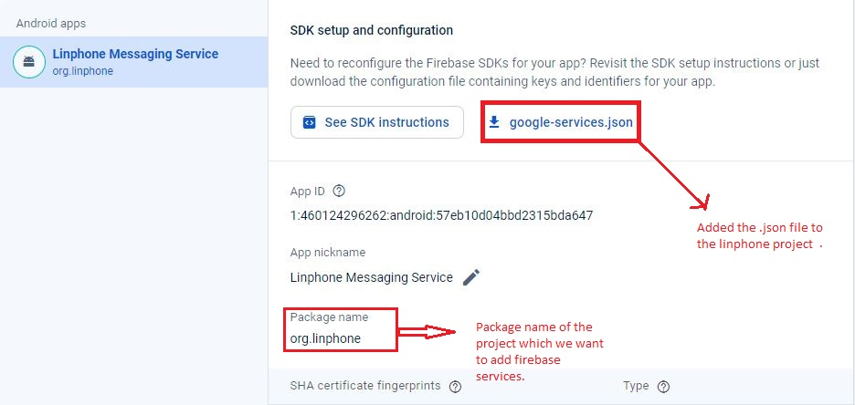
Methodology
Step 1 : Creating a firebase project

Slide 7
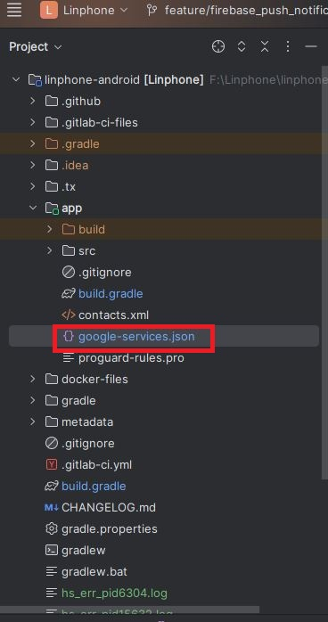
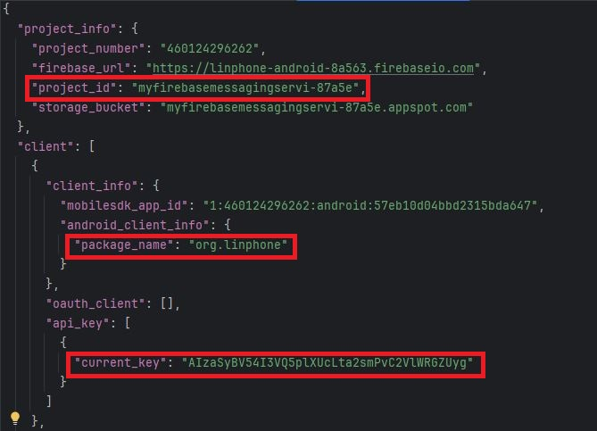
Methodology

Slide 8
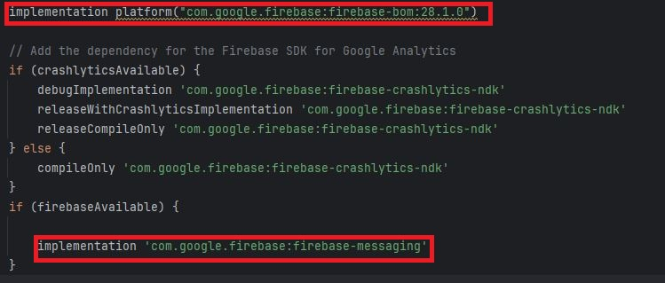
Methodology
Dependencies:

Slide 9
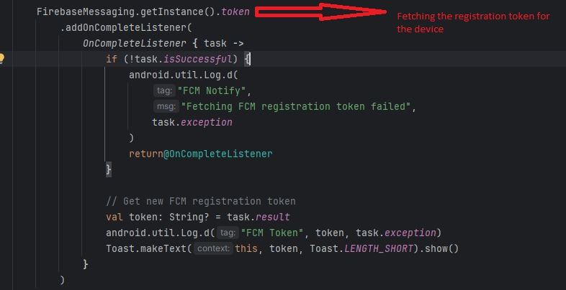
Methodology
Step 2 : Token Generation and Permission

Slide 10
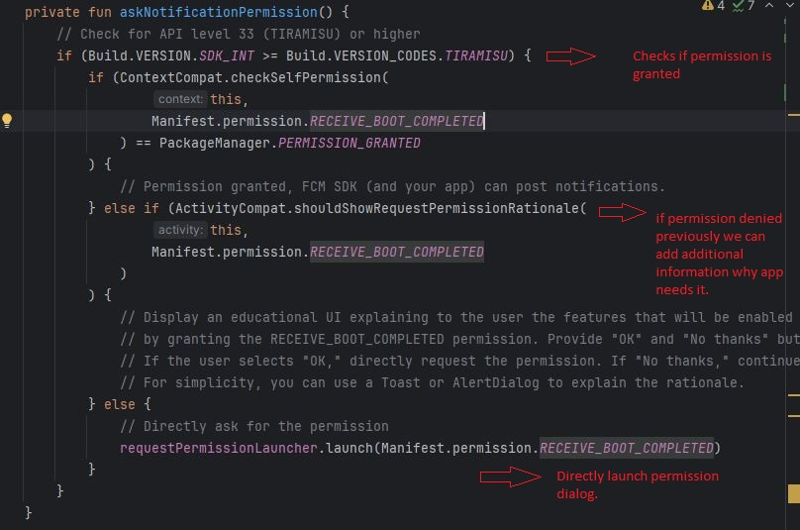
Methodology

Slide 11
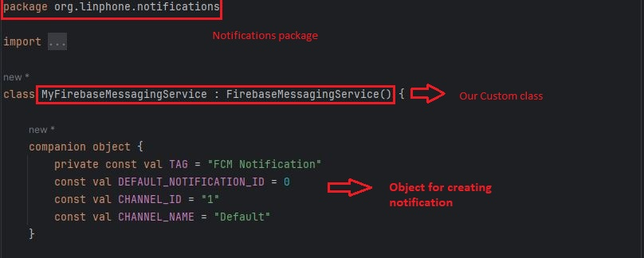
Methodology
Step 3: Setting up our own custom firebase messaging service class

Slide 12
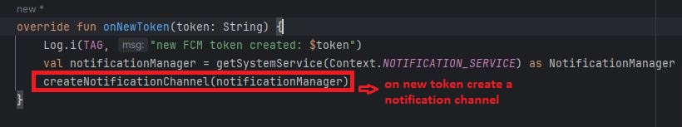
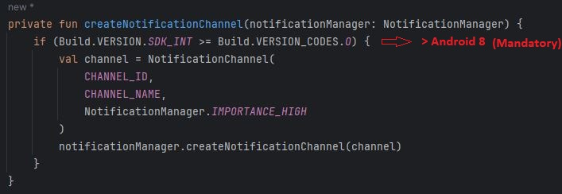
Methodology

Slide 13
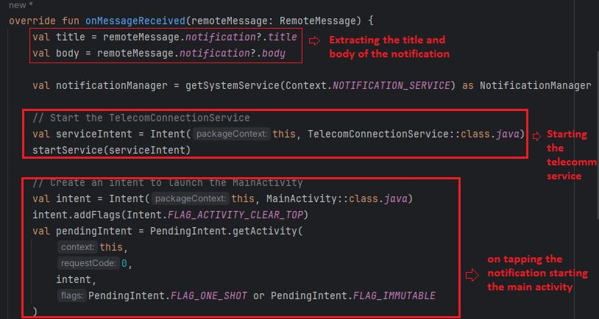
Methodology

Slide 14
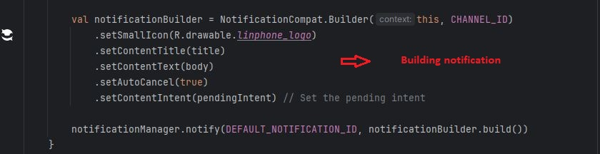
Methodology
Finally showing notification!!

Slide 15
Methodology
Finally showing notification!!

Slide 16
Methodology
A push notification server acts as a bridge between the VoIP server and the SIP application on the user's device.
When an incoming call arrives, the VoIP server sends a notification to the push notification server.
The push notification server then relays a notification to the user's device through Firebase Cloud Messaging (FCM) or a similar service.
The notification alerts the user about the incoming call and provides options to accept or reject the call.
Tapping the notification brings the SIP application to the foreground, allowing the user to answer the call.

Slide 17
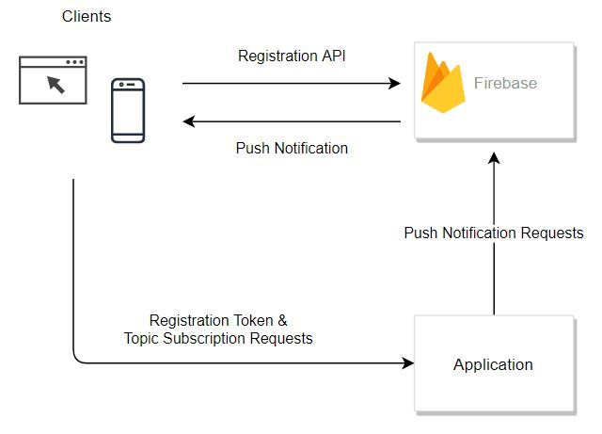
Methodology
Architecture of an FCM-based application

Slide 18
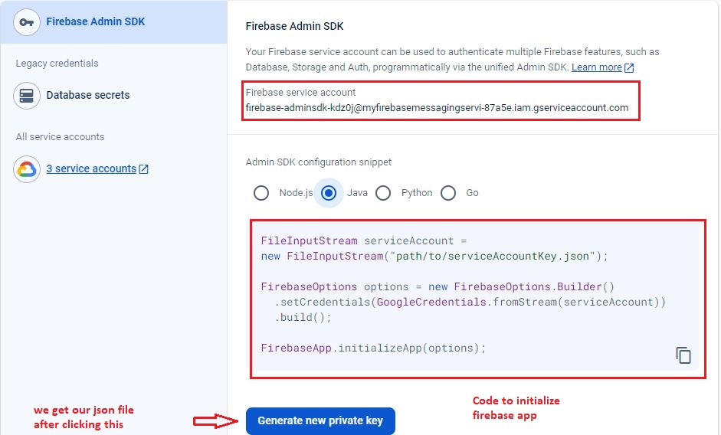
Methodology
Firebase service account

Slide 19
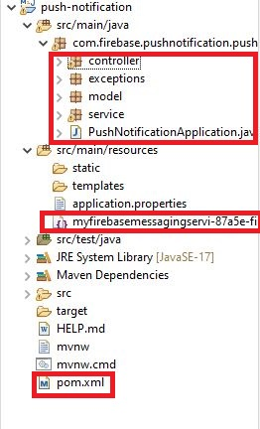
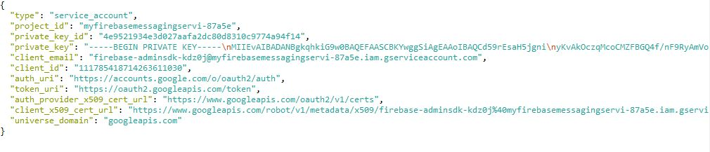
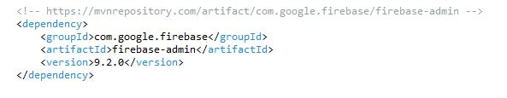
Methodology

Slide 20
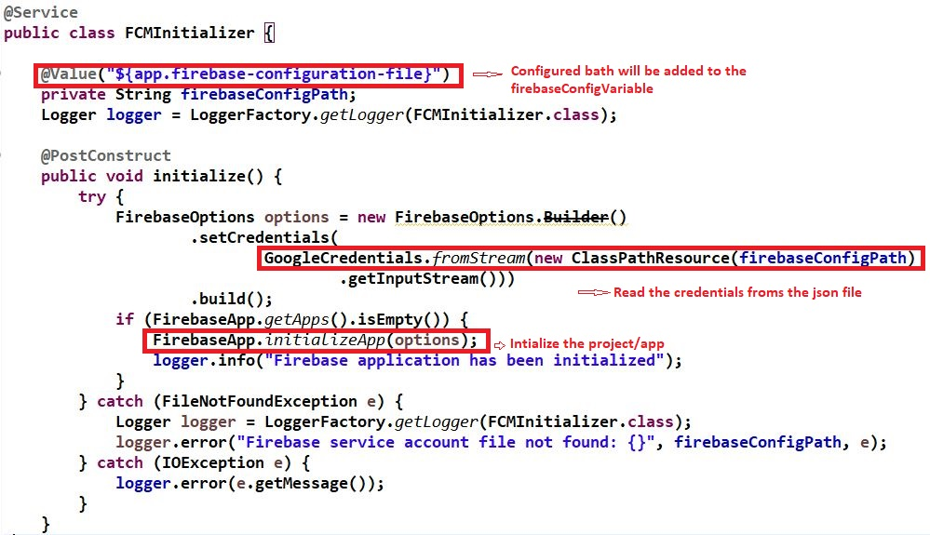
Methodology

Slide 21
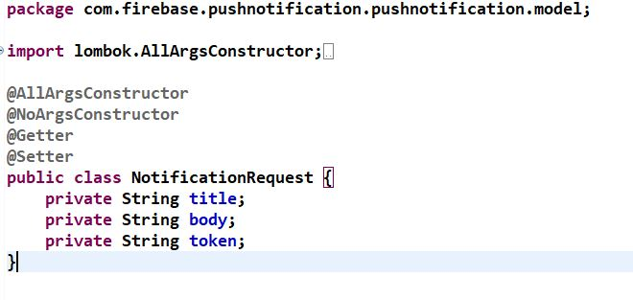
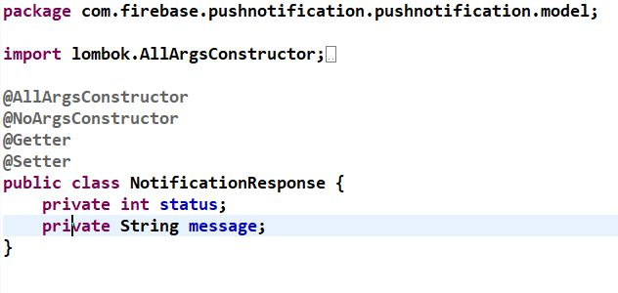
Methodology

Slide 22
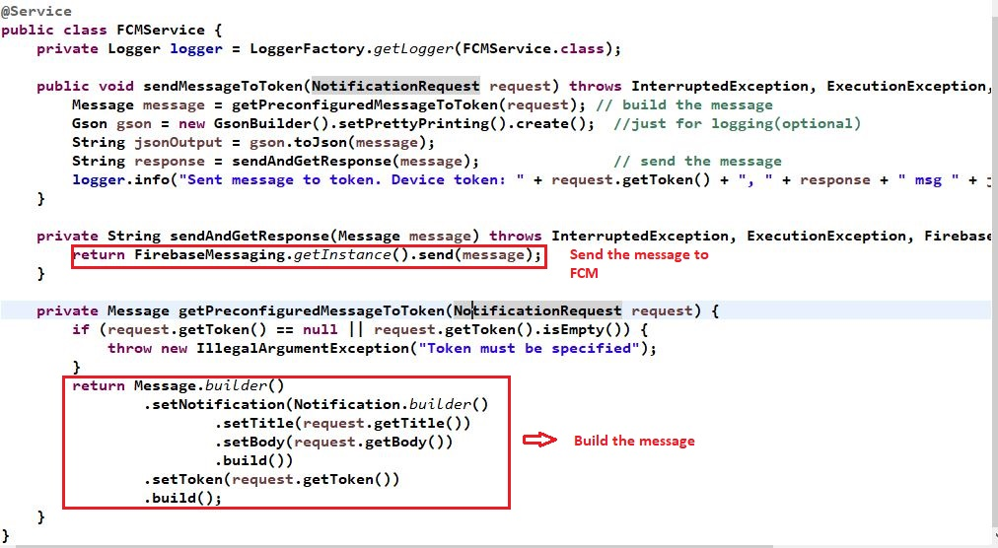
Methodology

Slide 23
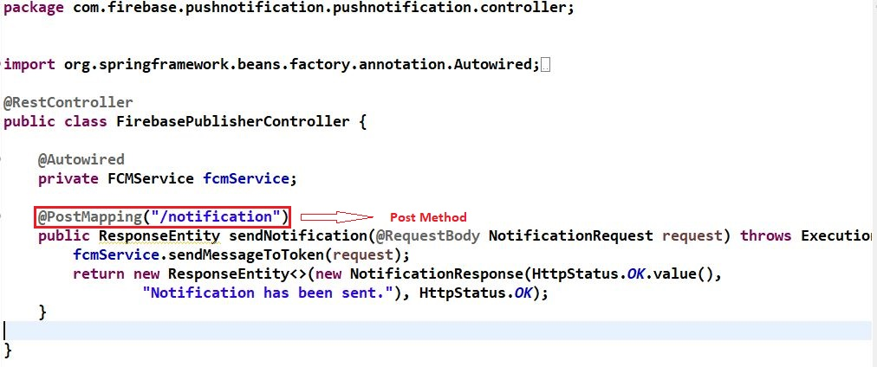
Methodology

Slide 24
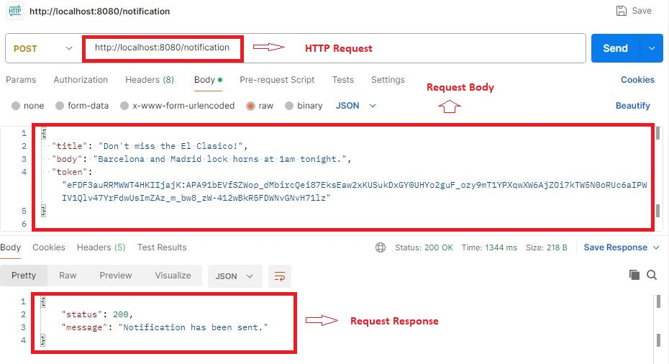
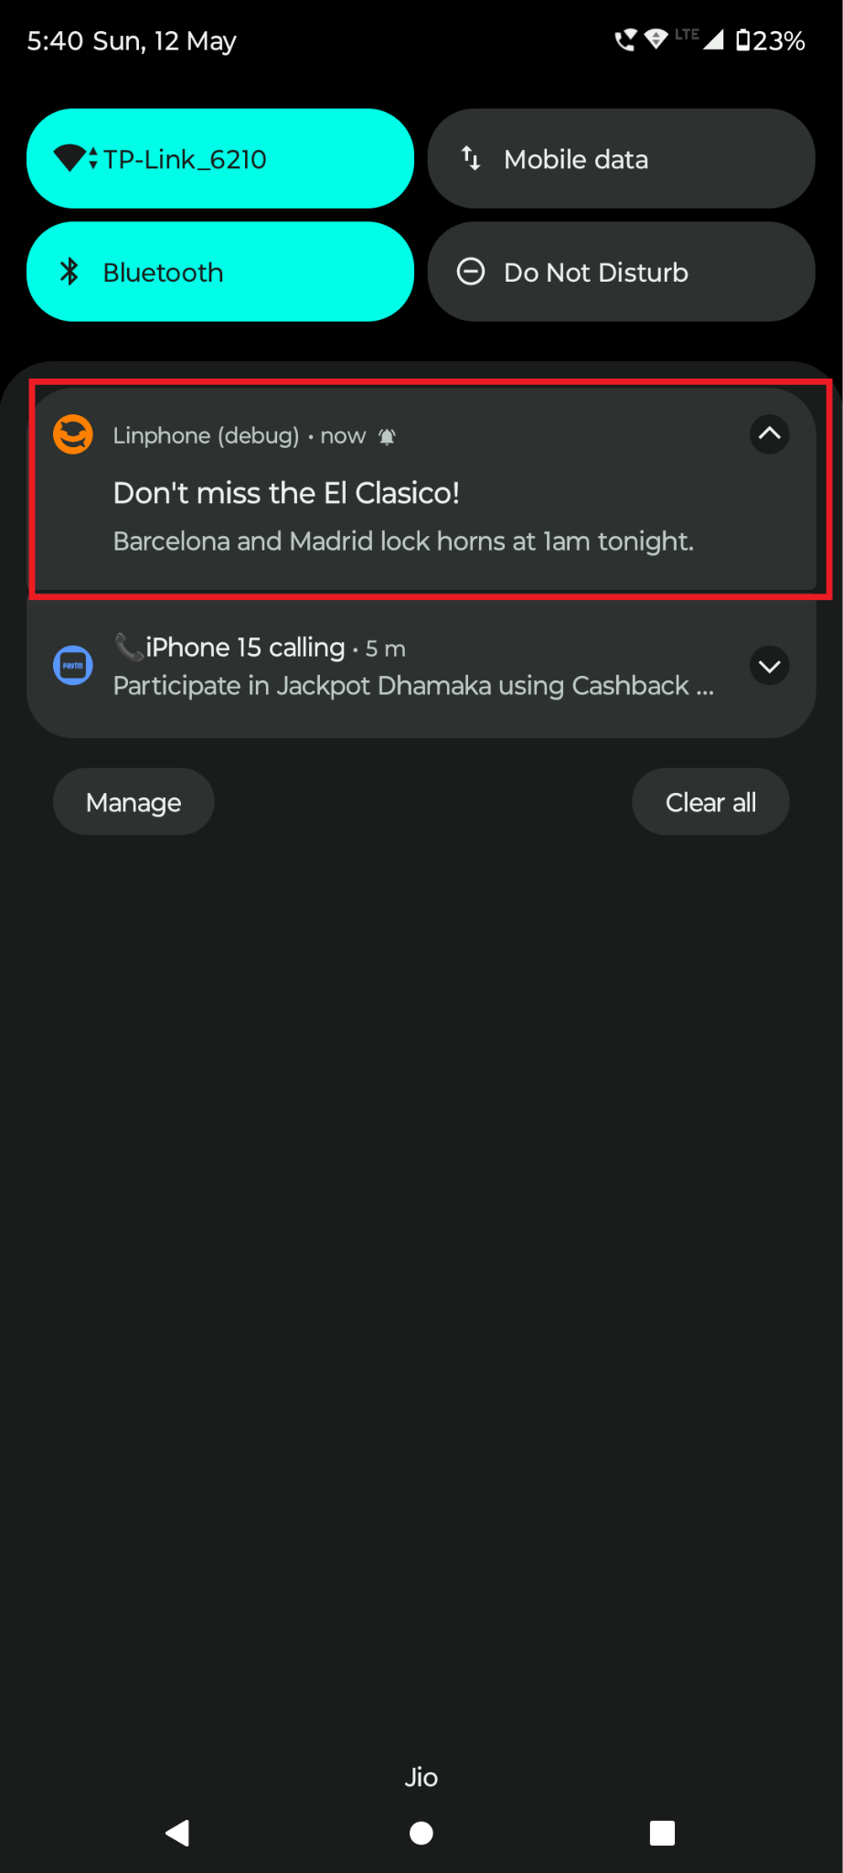
Result

Slide 25
Challenges
Understanding the Codebase Architecture of the Linphone.
Integrating the FCM into the source code.
Replacing the existing google-services.json file.
Configuring Firebase Admin account on the server side.

Slide 26
Key Learnings
Client-Side (Linphone VoIP):
Learned how to integrate Firebase Cloud Messaging (FCM) with a Linphone VoIP client application on Android to receive push notifications.
Understood how device registration tokens are obtained using FCM and their role in targeted notifications.
Learned how to handle the notification pushed by FCM on client device and show it on notification bar.

Slide 27
Key Learnings
Server-Side (Spring Boot):
Gained experience in building a Spring Boot application as the backend server for sending push notifications.
Explored the use of RESTful APIs for device token registration and notification sending within the Spring Boot controller layer.
Learned about the Spring Boot service layer and its role in implementing business logic for FCM initialization, interaction and device token management.

Slide 28
References
https://rutube.ru/video/9d437c44b037d7c54ba531ea66a572b1/
https://firebase.google.com/docs/cloud-messaging/android/client?authuser=0&hl=en
https://firebase.google.com/docs/cloud-messaging/send-message
https://medium.com/@rajdeepify/push-notifications-using-springboot-and-firebase-cloud-messaging-ad136746c57e

Slide 29
THANK YOU

